Slide 1
Weekly work

Slide 2
Add the information that the last edit data not null

Slide 3
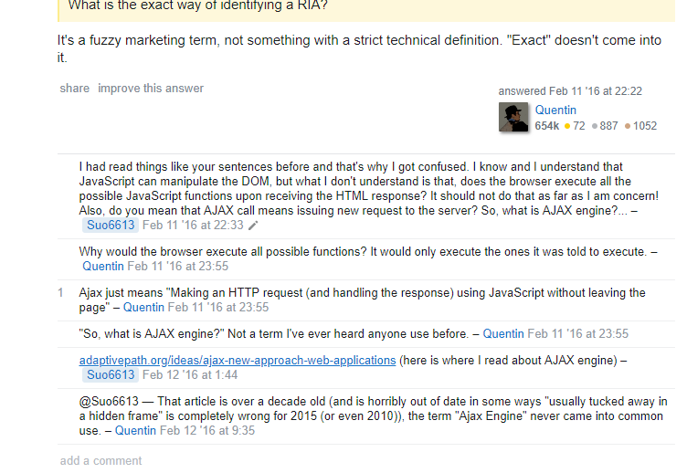
The author himself says out of date but not to his answer

Slide 4
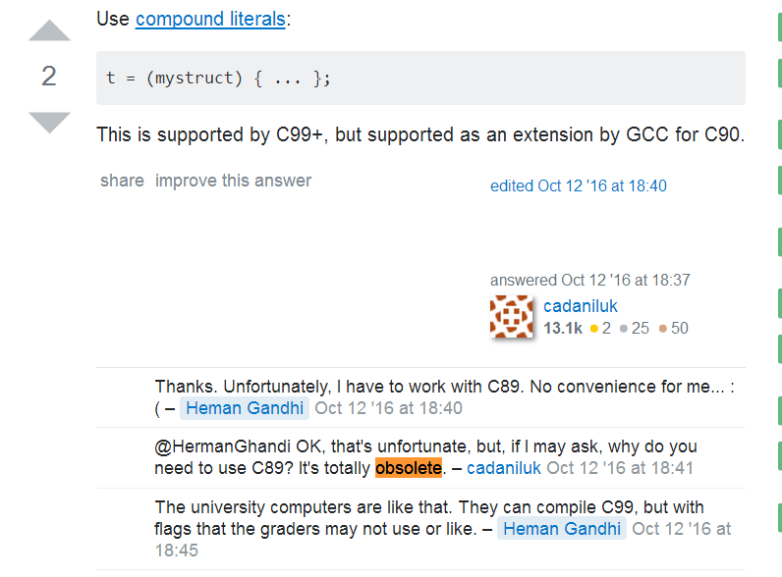
The author himself says out of date but not to his answer

Slide 5
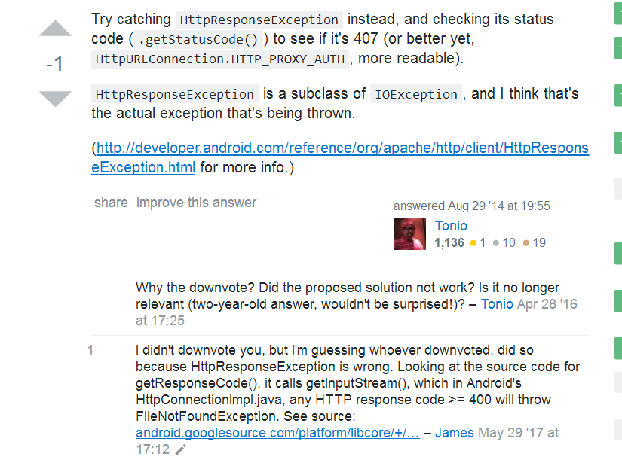
The author himself says out of date but not to his answer

Slide 6
The author himself says out of date but not to his answer
Select the answer author comments on his Answer, and his comments are accompanied by outdated keywords. 21080 in total.
Query 100 sentences and 88% negative.
Delete them and 61745 in total and 89% positive.

Slide 7
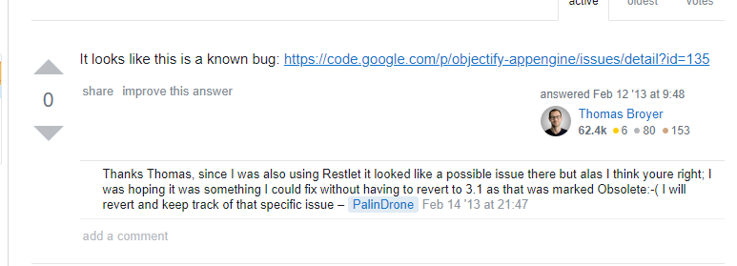
Can’t to deal with

Slide 8
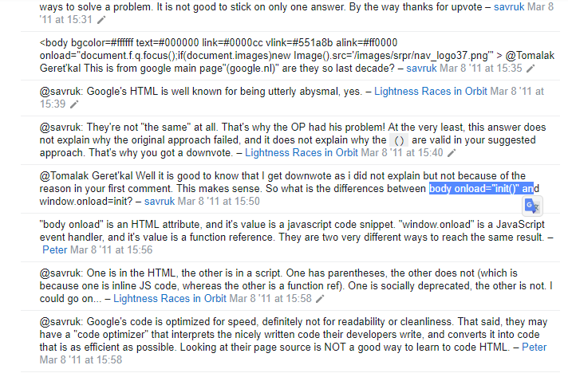
Discussing a technology not in answers.

Slide 9
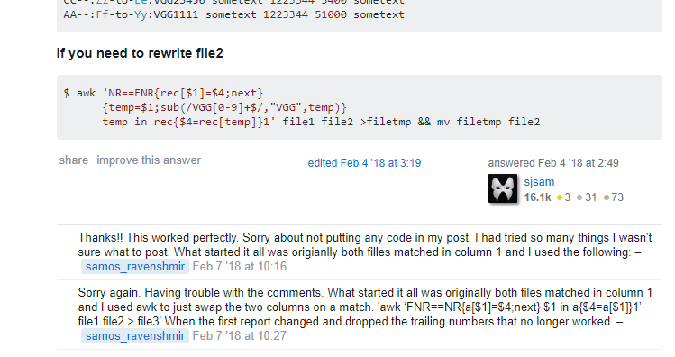

Slide 10
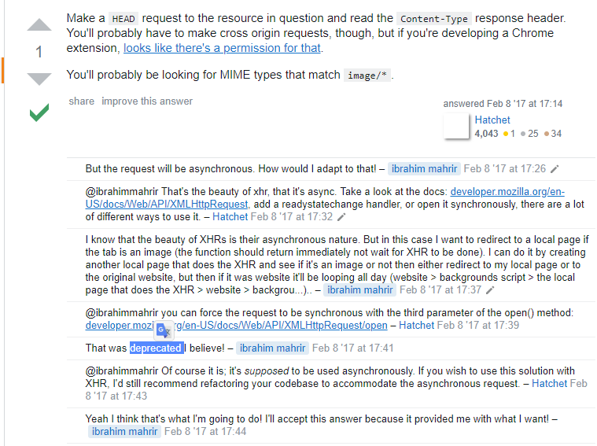

Slide 11
Solution
1.the number of comments
2.the creation data of Comments minus the Creation data of Answers.
3.Is the question’s Author said the comments with the keywords.
4.Too long Comments.

Slide 12
Negative samples : Query 80000w,downsampling
Model TextCNN 90% for train 10% for text 97% accuracy.

